Slide 1

Introduction to Virtual Entities
DYNAMICS 365 v9

Slide 2

Mitch Milam
mitch@xrmcoaches.com
@mitchmilam
linkedin.com/in/mitchmilam
youtube.com/xRMCoaches

Slide 3
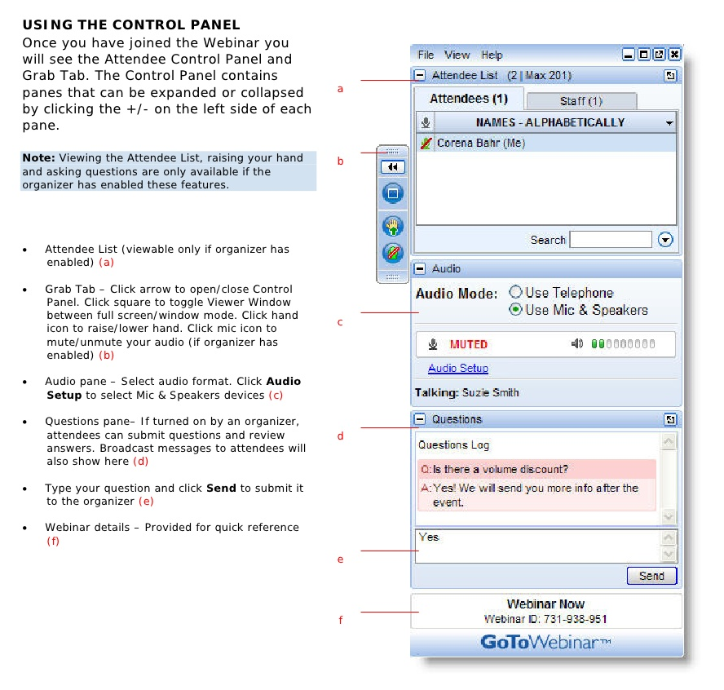
Webinar Housekeeping

Slide 4
Agenda
When
Where
Why
Technology
Tools

Slide 5
Overview
Available in Dynamics 365 Online v9 (only)

Slide 6
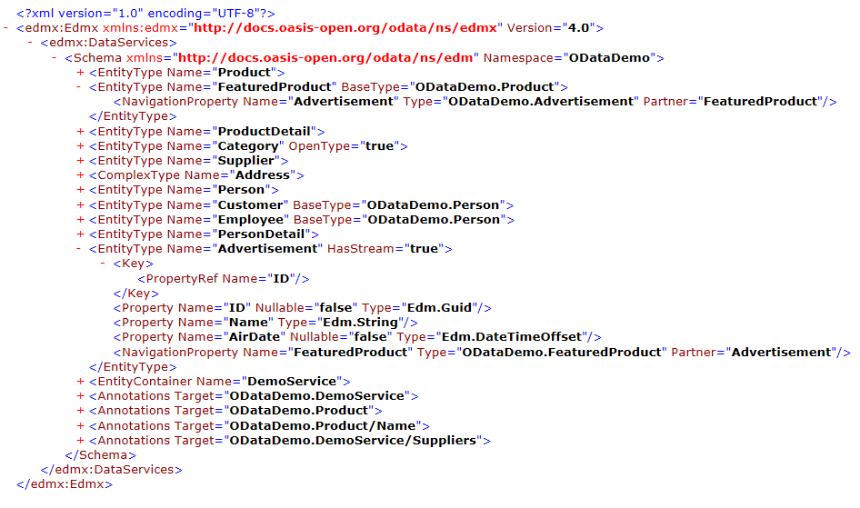
What Do You Need to Know?
You need to know and understand the .edmx file format

Slide 7
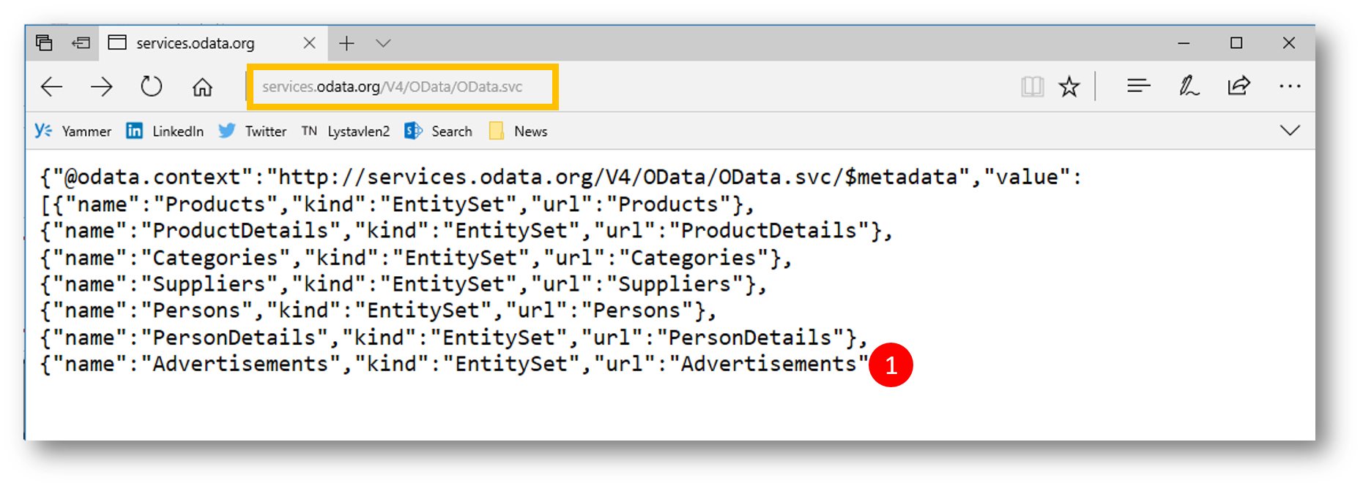
What Do You Need to Know?
You need to know how to read JSON format

Slide 8
Data Sources
OData v4
Azure Cosmos DB (from AppSource)

Slide 9
Limitations
Data is read-only
Only Organization-Owned entities are supported
Auditing and Change Tracking not supported
Not Queue-enabled
No Offline caching
Cannot be an Activity
Cannot have Business Process Flows
Cannot be switched back to a non-Virtual Entity

Slide 10
Data Model
ID field must be a GUID
All properties must represent Dynamics 365 attributes
Simple data types:
Text
Numbers
OptionSets
Dates
Images
Lookups
You must be able to model any entity relationships in Dynamics 365
Attributes cannot be calculated or roll-ups

Slide 11
For Developers
You can programmatically create a new Virtual Entity
Same rules apply as with manual creation
Data Source must exist
The Development Center article, API considerations of virtual entities contains a list of valid and invalid properties

Slide 12
Demo

Slide 13
Questions?

Slide 14
Thank You

